Slide 1
IT Research Methods
Chapter 2
Research Ideas and Hypotheses
Prof Kennedy Njenga

Slide 2
2.1 Getting Started: Identifying a Topic Area
The first steps of the research process:
  Step 1: find a research idea.
    Identify a general topic that interests you.
    Explore previous research in that topic to develop a research idea or question.
  Step 2: form a hypothesis.

Slide 3
Common Sources of Research Topics (1 of 2)
What are possible sources?
  Personal interests and curiosities
    Pick a topic about which you want to learn more.
  Casual observation
    Behavior of people or animals may generate a general research topic.
  Reports of others’ observations
    Ideas might come from informal sources (e.g., magazines or newspapers) or academic materials.

Slide 4
Common Sources of Research Topics (2 of 2)
Practical problems or questions
  Stemming from daily life (e.g., placement of audio controls for less distracted driving)
  General categories of research
    Applied research is directed toward solving practical problems.
    Basic research involves studies that are intended to solve theoretical issues.
Behavioral theories
  Testing predictions that are part of a theory

Slide 5
2.2 Searching the Existing Research Literature in a Topic Area
The literature: the mass of published information worldwide
Your job is to identify a handful of studies directly related to your research idea.
  This sounds daunting, but cross-referencing and summaries can help.

Slide 6
Tips for Starting a Review of the Literature (1 of 2)
Do your homework: collect background information.
  Read books and journal articles.
  Do not try to read everything.
    Read enough to gain a good grasp of your topic.

Slide 7
Tips for Starting a Review of the Literature (2 of 2)
Keep an open mind.
  Begin with a general topic and let background reading lead you to a more specific topic.
  Be critical; ask questions as you read.
  Maintain a degree of flexibility.
Focus, focus, focus.
  Develop one research question and find relevant background information.
Take one step at a time.

Slide 8
Primary and Secondary Sources
Primary sources: firsthand reports in which the authors describe their own observations
  Examples: empirical journal articles/theses
Secondary sources: secondhand reports in which the authors discuss someone else’s observations
  Examples: textbooks/introductory sections of research reports

Slide 9
The Purpose of a Literature Search
Two basic goals:
  To gain a general familiarity with the current research in your specific area of interest
  To find a small set of research studies to serve as the basis for your research idea
Find a set of published research reports defining the current state of knowledge
  Identify a gap in that knowledge base that your study will attempt to fill

Slide 10
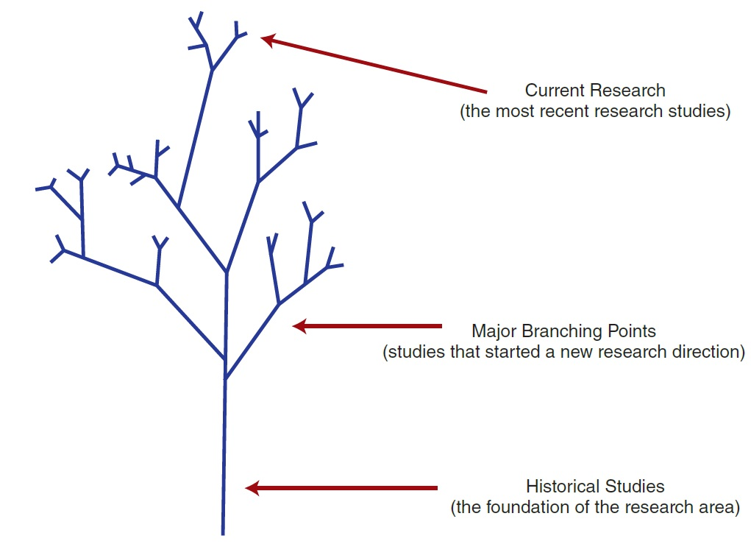
How New Research Grows Out of Old
Notes:
Figure 2.1 How Research Grows Out of Old
The tree-like structure emphasizes the notion that current research (the tips of the branches) is always based in previous research.

Slide 11
Conducting a Literature Search (1 of 2)
Your purpose: narrow down your general idea to a specific research question.
  Find all published information to document and support that question.
A good starting point: recently published secondary sources
  A textbook, chapter headings, and subheadings will help focus your search on a more narrowly defined area.

Slide 12
Conducting a Literature Search (2 of 2)
Make note of subject words.
  List correct terms or subject words.
    These words identify and describe the variables in the study and the characteristics of the participants.
Make note of author names.
  The same authors’ names encountered repeatedly are likely the current leading researchers in the field.

Slide 13
Using Online Databases
A typical database contains about one million publications.
  Cross-referenced by subject words and author names
  Search the database by subject word or author name
  Articles listed by the search may be:
    Brief summaries
    Abstracts
    Full-text

Slide 14
Information About PsycINFO Database
PsycINFO is the American Psychological Association’s (APA) definitive resource for abstracts of scholarly journal articles, book chapters, books, and dissertations.
  Largest resource devoted to peer-reviewed literature in behavioral science and mental health
Notes:
Table 2.1
Information About PsycINFO® and PsycARTICLES® Databases

Slide 15
Information About PsycARTICLES Database
PsycARTICLES is the American Psychological Association’s (APA) definitive source of full-text, peer-reviewed scholarly and scientific articles in psychology.
  Contains more than 163,000 articles from more than 80 journals published by the APA, the Educational Publishing Foundation (EPF), and from allied organizations
Notes:
Table 2.1
Information About PsycINFO® and PsycARTICLES® Databases

Slide 16
Information About ERIC Database
ERIC (Education Resource Information Center) provides access to education literature and resources.
  Information from journals included in the Current Index of Journals in Education and Resources in Education Index
    More than 1.3 million records and links to more than 323,000 full-text documents dating back to 1966
Notes:
Table 2.1
Information About ERIC and MEDLINE Databases

Slide 17
Information About MEDLINE Database
MEDLINE with Full Text
  Provides the authoritative medical information on medicine, nursing, dentistry, veterinary medicine, the health care system, and preclinical sciences
    Features full text for more than 1,470 journals indexed in MEDLINE
Notes:
Table 2.1
Information About ERIC and MEDLINE Databases

Slide 18
Using PsycINFO
The APA offers video guides for using PsychINFO for a literature search: www.youtube.com/psycinfo
Check with a teacher or reference librarian to help you get started.
Notes:
Table 2.1
Information About PsycINFO® and PsycARTICLES® Databases

Slide 19
Screening Articles During a Literature Search
Ways to weed out irrelevant material:
  Use the title as your first basis for screening.
  Use the abstract as your second screening device.
  Look for a link to a full-text version.
  If the article still looks relevant, then read it carefully.
  Use references from articles you have already found to expand your literature search.

Slide 20
Ending a Literature Search
The search is completed when you:
  feel comfortable with your knowledge about the topic area, and
  have found a few recent research studies that are particularly relevant to your own interests.
How many articles is enough?
  The key criterion is that the study (or studies) you find provides some justification for new research.

Slide 21
2.3 Finding an Idea for a Research Study from a Published Research Article
How can existing publications lead to an idea for a new research study?
  Authors generally make explicit statements regarding:
    unanswered questions
    suggestions for future research
    limitations to their studies
  Create a new idea from two existing results
  Use knowledge of components of a research article
    Especially introduction, discussion, and references

Slide 22
The Components of a Research Article—Critical Reading (1 of 2)
Section | Content | Critical Evaluation Questions
Introduction | Literature review | Is the review complete and up to date? Are relevant or related topics not covered? Is the hypothesis clearly stated?
 | Hypothesis or purpose for study | Is the hypothesis directly related to the reviewed literature? Does the predicted outcome logically follow from the hypothesis?
 | Specific prediction from hypothesis | Can other specific predictions be made?
Method | Participants | Are the participants representative of the population being considered? If participants were restricted (e.g., males only), is it justified? Would different participants produce different results? Are there alternative ways to define and measure the variables?
 | Procedure | Could alternative procedures be used?
Notes:
Table 2.2
Critically Reading a Research Article

Slide 23
The Components of a Research Article—Critical Reading (2 of 2)
Section | Content | Critical Evaluation Questions
Results | Statistics (descriptive and inferential) | Were the appropriate statistics used? Exactly what is significant and what is not? Are the effects large enough to be meaningful?
Discussion | Results related to hypothesis | Do the results really support (or refute) the hypothesis? Are the conclusions justified by the results?
 | Justified conclusions | Are alternative conclusions/explanations possible?
 | Alternative explanations | Would other variables affect the results? Do the results have real-world applications?
 | Applications Limits to generalization | Is there reason to suspect that the same results would not occur outside the lab? Would the same results be expected with different participants or under different circumstances?
References | List of items cited | Is the list of references current and complete?
Notes:
Table 2.2
Critically Reading a Research Article

Slide 24
2.4 Using a Research Idea to Form a Hypothesis and Create a Research Study
What are the characteristics of a good hypothesis?
  Logical: the logical conclusion of a logical argument
  Testable: all of the variables, events, and individuals can be defined and observed
  Refutable: can be demonstrated to be false
  Positive: must make a positive statement about the existence of something

Slide 25
Using a Hypothesis to Create a Research Study
The research process—steps 3 and 4:
  Step 3: specify how the variables will be defined and measured.
  Step 4: identify the individuals who will participate in the study, describe how they will be selected, and provide for their ethical treatment.
Different research studies can be developed from the same hypothesis.

